Slide 1

Macroeconomics
3.1
Copyright Bananaomics

Slide 2

Macreconomic Objectives
Copyright Bananaomics

Slide 3

3 Macro Objectives
  Economic Growth
  Low Unemployment Rate
  Low and Stable Inflation
Possible additional goals: Sustainable Debt, Equity, and Income Distribution
Copyright Bananaomics

Slide 4
Circular Flow
Copyright Bananaomics

Slide 5


Closed Circular Flow
Households
Goods and Services
Factors of Production
Payment for Goods and Services
Payment for FOP
Product Market
Resource Market
Payment for Goods and Services
Payment for FOP
Goods and Services
Factors of Production
Firms
Copyright Bananaomics

Slide 6
Open Circular Flow
Leakages - Money that flows out of an economy (Savings, Taxes, Imports)
Injections - Money that flows into an economy (Investments, Government Spending, Exports)
OUTFLOW
Households
Goods and Services
Factors of Production
Imports
Savings
Taxes
Foreign Countries
Financial Institutions
Government
Payment for Goods and Services
Payment for FOP
Product Market
Resource Market
Exports
Investment
Government Spending
Payment for Goods and Services
Payment for FOP
Goods and Services
Factors of Production
INFLOW
Firms
Copyright Bananaomics

Slide 7
Intro Activity
Select a country and research the following for the last 5 years:
  Levels of GDP, Real GDP, and GDP Per Capita
  Rate of Inflation
  Rate of Unemployment
  Income Distribution
  Trade Balance (Level of Exports vs Level of Imports
Then ...
Create a visual using that information and Kognity to:
  Define each Indicator
  Explain each figure and what they demonstrate
  Explain the impact on stakeholders
  Your comment on the current state of the economy.
Copyright Bananaomics

Slide 8

Measuring Economic Activity
Copyright Bananaomics

Slide 9

Gross Domestic Product
The total MONETARY value of all FINAL goods and services produced DOMESTICALLY within a YEAR.
The most common tool, with it's various alterations, to measure economic growth.
Problems arise due to MNC(Multinational Corporations).
Copyright Bananaomics

Slide 10

GDP Formula
GDP = C + I + G + (X-M)
C - Consumption - Purchases on final goods and services by individuals.
I - Investment - Business spending on tools and equipment.
G - Government Spending - Schools, Roads, Military
(X-M) - Net Exports
Copyright Bananaomics

Slide 11


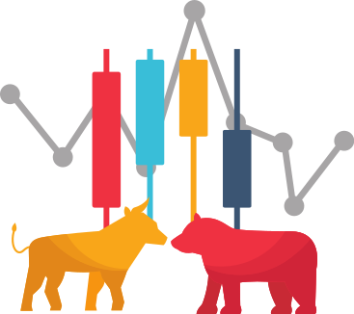

Things Not Included in GDP
Intermediate Goods
- Goods used in the production of final goods and services
Non-Production Transactions
- Used Goods
- Financial Transactions
Illegal Activities
Copyright Bananaomics

Slide 12
Included or Not?
Determine whether each component is included or not in GDP for Germany. Upon completion, calculate the GDP.
  7 Euros for a meal
  1 Million Euro for military expenditures
  6,000 Euros for a used car
  BMW invests 5 Million Euros for a new factory
  20,000 Euros for an Audi made and sold in the US
  45,000 Euro profit from selling stocks
  15,000 Euro Volkswagen made in Germany and sold in China
  10,000 Euro for a house remodel
  200 Euro welfare payment to low-income families
  100,000 Euro for a new office building for a start-up company.
Copyright Bananaomics

Slide 13
Included or Not?
GDP = 6, 125, 007
  7 Euros for a meal
  1 Million Euro for military expenditures
  6,000 Euros for a used car
  BMW invests 5 Million Euros for a new factory
  20,000 Euros for an Audi made and sold in the US
  45,000 Euro profit from selling stocks
  15,000 Euro Volkswagen made in Germany and sold in China
  10,000 Euro for a house remodel
  200 Euro welfare payment to low-income families
  100,000 Euro for a new office building for a start-up company.
Copyright Bananaomics

Slide 14
To account for MNCs ... we use
Gross National Product (GNP)
The total monetary value of all final goods and services produced by factors owned by the country’s citizens in a given period of time.
Gross National Income (GNI)
The total income of a nation’s people and businesses.
Copyright Bananaomics

Slide 15

National Income
Measure of total economic activity that takes place within an economy.
Copyright Bananaomics

Slide 16

How to measure National Income?
Output Method
Firms provide figures for their output during the year.
Benefits
- Allows for good statistical data based on sectors.
Problems
- Does not include informal economic activities
Copyright Bananaomics

Slide 17

How to measure National Income?
Income Method
Done by adding up all the income earned by groups when the factors of production are sold in resource markets.
Benefits
- Relatively simple if all jobs are registered.
Problems
As before, does not include unregistered payments or "under the table" money.
- Corruption and criminal activities could distort statistics
- Informal jobs such as babysitting would also not be counted.
Copyright Bananaomics

Slide 18

How to measure National Income?
Expenditure Method
Done by adding up total sales receipts for goods and services sold in the economy.
Benefits
- In a closed economy, this is simple Consumption. However, in an open economy many other variables are at play such as government spending, investment, and Net Export
Most Commonly Used
Copyright Bananaomics

Slide 19
GNI Formula
Expenditure Method
GNI = GDP + (Incomes flowing into the country - Incomesflowing out of the country)
Copyright Bananaomics

Slide 20

Practice
Copyright Bananaomics

Slide 21
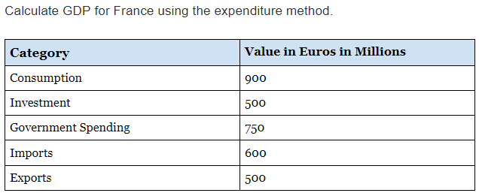
Practice
Copyright Bananaomics

Slide 22
Solution
GDP =
900 + 500 + 750 + (500-600)
2050 Euros (Millions)
Copyright Bananaomics

Slide 23
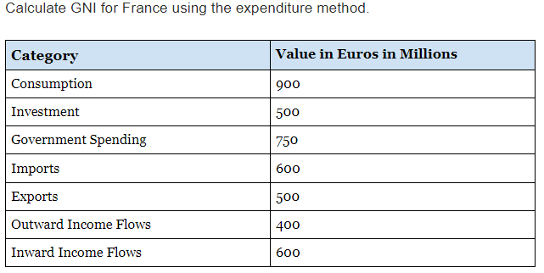
Practice
Copyright Bananaomics

Slide 24
Solution
GNI =
2050 + (600-400)
2250 Euros (Millions)
Copyright Bananaomics

Slide 25

What do you think is the most popular movie of all time?
Copyright Bananaomics

Slide 26
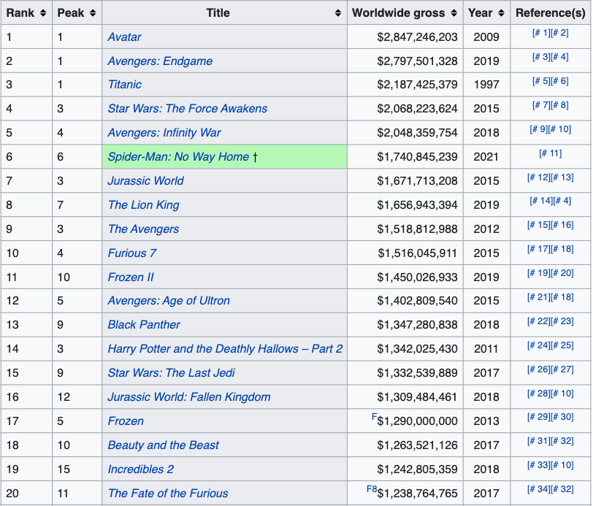

Nominal Box Office Receipts
What is the problem here?
WHA
Copyright Bananaomics

Slide 27
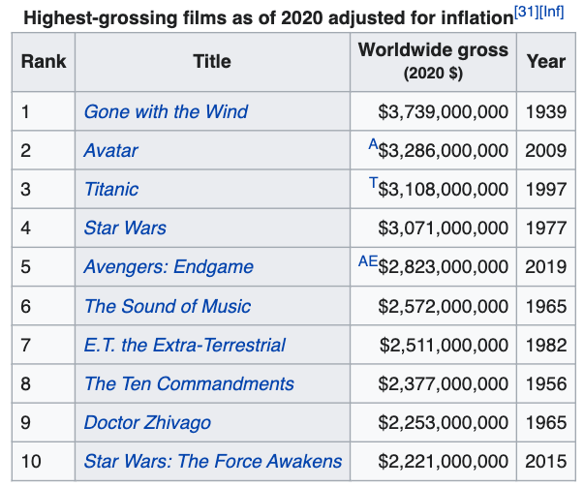

Real Box Office Receipts
Adjusted for Inflation
WHA
Copyright Bananaomics

Slide 28
Real Vs Nominal GDP
Nominal GDP/GNI
GDP/GNI measured in current prices that does not account for inflation.
Real GDP/GNI
GDP/GNI that is adjusted for inflation.
Which is better to measure growth?
Copyright Bananaomics

Slide 29

Real GDP/GNI
Calculated by using a "Deflator". These deflators essentially deflate the nominal values allowing for an accurate Real GDP.
Nominal GDP/GNI
________________
Real GDP/GNI =
X 100
Price Deflator
Copyright Bananaomics

Slide 30
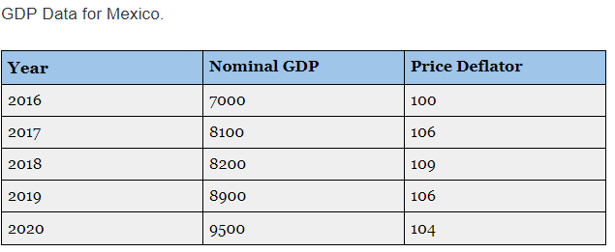
Real GDP/GNI
Calculate the Real GDP for Mexico from 2016-2020.
Make a statement regarding the trend of the Real GDP data for Mexico
Copyright Bananaomics

Slide 31
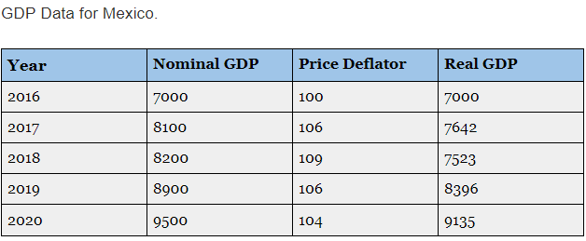
Real GDP/GNI
Copyright Bananaomics

Slide 32

Purchasing Power Parity (PPP)
Gives an accurate depiction of the size of an economy by its power to purchase goods and services within that country.
Used to compare productivity and standards of living between countries by looking at relative costs of goods and services.
You may experience this when you travel. Basic goods and services can be cheaper or more expensive in other countries.
Copyright Bananaomics

Slide 33

VISUAL CAPITALIST - THE WORLDS 10 LARGEST ECONOMIES IN 2030
Copyright Bananaomics

Slide 34
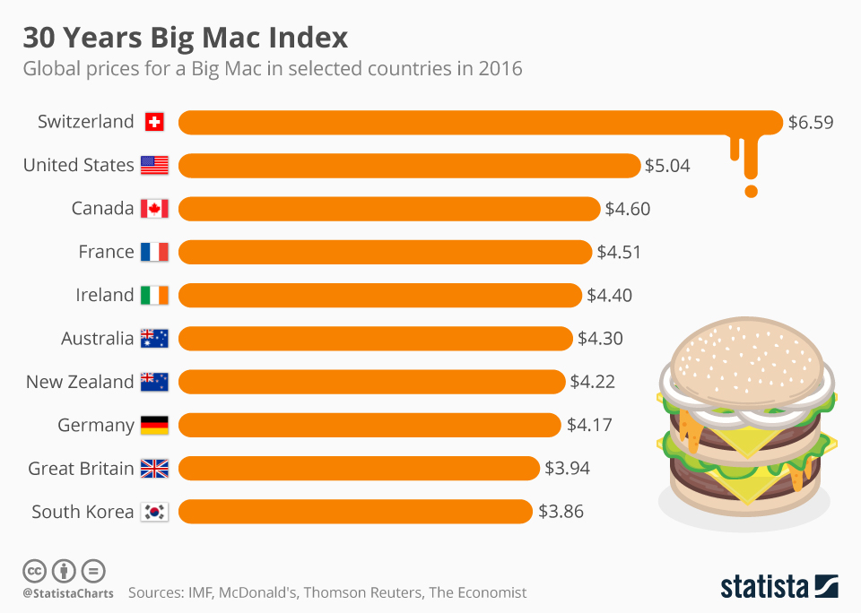
Purchasing Power Parity (PPP)
Big Mac Index
Copyright Bananaomics

Slide 35

GDP Per Capita
GDP divided by population. Gives an accurate depiction of the average income per citizen.
Copyright Bananaomics

Slide 36

Pros and Cons of GDP
Advantages
  Easy to compare countries
  Informs Policymakers and agendas
  Gives an indication of average income (GDP Per Capita)
Limitations
  Overestimates quality of life
  Does not account for inequality or income disparity
  Difficult to measure and contains inaccuracies
  Does not account for improvement of quality
Copyright Bananaomics

Slide 37
TIME TO FIX GDP?
Copyright Bananaomics

Slide 38
The Business Cycle
Copyright Bananaomics

Slide 39
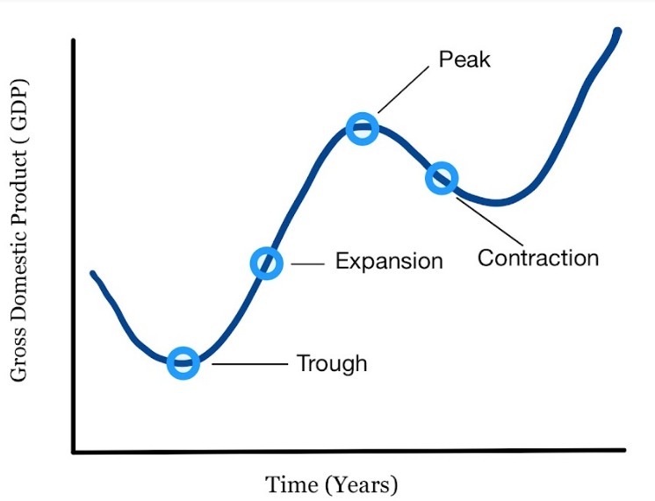
Business Cycle
Copyright Bananaomics

Slide 40
Business Cycle Activity
  Draw the business cycle
  Label Each of the main stages
  Draw arrows on the business cycle to indicate what you believe happens to the following at EACH stage:
        GDP Growth
        Unemployment
        Inflation
        The relationship between exports and imports
        The relationship between actual and potential output
Copyright Bananaomics

Slide 41
ACDC ECON - BUSINESS CYCLE
Copyright Bananaomics

Slide 42

Alternative Measures of an Economic Well-Being
Copyright Bananaomics

Slide 43



Alternative Measures
GDP and GNI don't take other factors into account such as well-being, happiness, environmental sustainability, etc.
Copyright Bananaomics

Slide 44

Alternative Measures
OECD Better Life Index
Focuses on a specific subset of data such as health, education, income, life satisfaction, work-life balance, etc.
Happy Planet Index
life expectancy × well-being × inequality
ecological footprint
Happiness Index
Survey participants are asked to access their happiness on a "Cantril Ladder"
Copyright Bananaomics

Slide 45

Practice Question
Copyright Bananaomics

Slide 46
Paper 1 Part A
N18/3/ECONO/SP1/ENG/TZ0/XX
Copyright Bananaomics

Slide 47
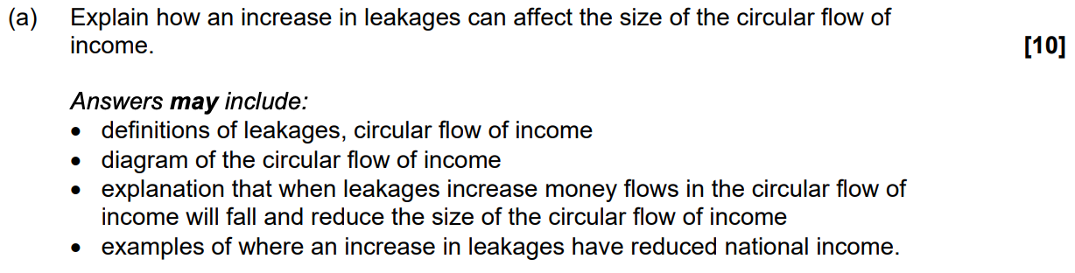
Check Answers
Copyright Bananaomics

Slide 48

Enjoying The Content?
Visit bananaomics.com to purchase package deals with discount prices!
BANANAOMICS

